Slide 1

Green Pace
Security Policy Presentation
Developer: Mitchell Wolfrom Velez
Standardized C/C++ Secure Development & DevSecOps Policy

Slide 2
OVERVIEW: DEFENSE IN DEPTH
As Green Pace scales, implicit developer habits must be standardized to eliminate structural vulnerabilities and prepare compliance audits.
We operate on the assumption that any single perimeter defense can be breached. Every unvalidated input, memory buffer, and API endpoint expands our attack surface.
This policy embeds overlapping security controls directly into our C++ codebase, system architecture, and automated CI/CD pipelines.

Slide 3


Slide 4
THREATS MATRIX
Threats are categorized by Severity, Likelihood, and Remediation Cost (Levels 1–5). High-priority threats are automatically detected pre-build via SAST (SonarQube, Cppcheck) and dynamically via Valgrind and ThreadSanitizer.
STD-002-CPP (Integer Overflows), STD-003-CPP (Unbounded String Copies), STD-004-CPP (SQL Injection) | STD-003-CPP (Level ​5), STD-004-CPP​ (Level 5), STD-002-CPP (Level 4), STD-005-CPP (Memory Protection - Level 4), STD-008-CPP (Concurrency Data Races - Level 4), STD-009-CPP (Path Traversal - Level 4)
STD-001-CPP (Data Type Truncation - ​Level 3), STD-010-CPP​ (Sensitive Data Exposure - Level 3), STD-006-CPP (Assertions - Level 2), STD-007-CPP (Exceptions - Level 2) | STD-006-CPP (Assertions in Runtime), STD-010-CPP (Unclear Memory Buffers)

Slide 5
10 PRINCIPLES
​​Validate Input Data: STD​-002-CPP, STD-003-​CPP, STD-004-CPP​, STD-009-CPP
​​Heed Compiler Warnings: STD​-001-CPP
​​Architect and Design for Security Policies: STD​-005-CPP, STD-008-CPP
​​Keep It Simple: STD​-006-CPP, STD-007-CPP
​​Default Deny: STD​-009-CPP
​​Adhere to the Principle of Least Privilege: STD​-009-CPP
​​Sanitize Data Sent to Other Systems: STD-004-CPP​
​​Practice Defense in Depth: STD​-003-CPP, STD-010-CPP
​​Use Effective Quality Assurance Techniques: STD​-002-CPP, STD-006-CPP, STD-008-CPP
​​Adopt a Secure Coding Standard: STD​-001-CPP, STD-005-CPP, STD-007-CPP, STD-010-CPP

Slide 6
CODING STANDARDS
Ranking System: Prioritized using SEI CERT risk scoring (Severity × Likelihood vs. Remediation Cost) on a 1–5 scale:
Level 5 (Critical Priority - Remediate Immediately):
​​STD-003-CPP (String Correctness​: Replace strcpy with bounded strncpy)
STD-004-CPP (SQL Injection: Enforce sqlite3_prepare_v2 parameterized queries)
Level 4 (High Priority - Next Sprint):
STD-002-CPP (Data Value: Pre-check arithmetic against INT_MAX)
STD-005-CPP (Memory Protection: Nullify pointers after delete / use Smart Pointers)
STD-008-CPP (Concurrency: Use std::atomic to prevent ​data races)​
​​STD-009-CPP (File I/O​: Sanitize paths to block .. directory traversal)
Level 3 (Medium ​Priority): STD-001-CPP (Data Type​ bounds), STD-010-CPP (Zeroing memory via memset_s)
Level 2 (Low Priority): STD-006-CPP (No assert() in runtime logic), STD-​007-CPP (Catch exceptions by const reference; avoid​ catch(...) error hiding)

Slide 7
ENCRYPTION POLICIES
​​Encryption at Rest (AES-256​):
What & Where: Cryptographic protection applied universally to all stored databases, file systems, and cloud backups.
Rationale: Prevents ​data exfiltration if physical drives or​ database volumes are compromised.
​​Encryption in Flight (TLS 1.3​):
What & Where: Enforced across all external ​client-server web​ traffic and internal microservice API communications.
Rationale: Eliminates ​Man-in-the-Middle (MITM​) packet sniffing and session hijacking.
Encryption in Use (Confidential Computing & Memory Scrubbing):
What & Where: Hardware-based secure enclaves (RAM) and explicit buffer zeroing (memset_s per STD-010-CPP) during active processing of PII and keys.
Rationale: Defends against memory-scraping malware and core-dump harvesting.

Slide 8
TRIPLE-A POLICIES
Authentication (Verifying Identity):
​​Policy: Enforces Multi-Factor Authentication (MFA​), strict password complexity, and identity verification during user logins, database connections, and the addition of new users.
Enterprise Integration: Centrally governed via Active Directory (AD) and LDAP.
Authorization (Enforcing Least Privilege):
Policy: ​Role-Based Access Control (RBAC​) dictates ​user level of access​, restricts ​files accessed by users​, and gates who can execute changes to the database.
Accounting (Non-Repudiation & Auditing):
Policy: Centralized SIEM continuously ingests OS, firewall, and application logs to track logins, file access, and database modifications for forensic auditing.

Slide 9
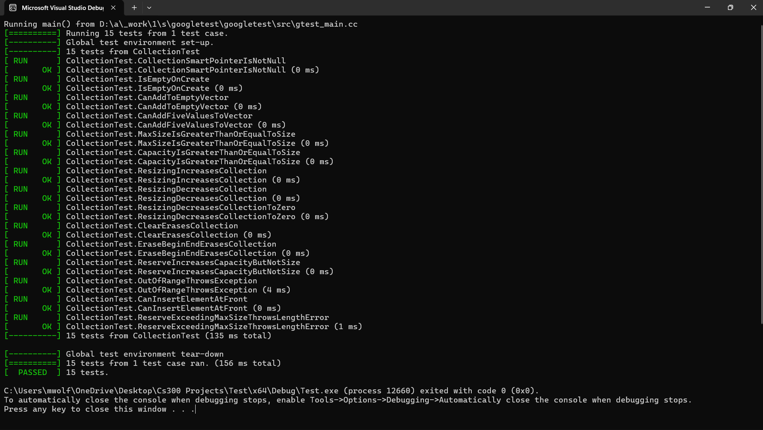
Unit Testing
Test 1: Can We Safely Add Elements & Resize a Dynamic Collection? (Positive Tests)
Vulnerability Tested: Memory Management & Buffer Allocation (STD-005-CPP / std::vector container safety).
Positive Tests Executed: CanAddFiveValuesToVector & ResizingIncreasesCollection.
Application: Uses Google Test ASSERT_GT and EXPECT_EQ macros inside the CollectionTest fixture to verify that dynamic vector growth accurately updates size without corrupting pointers.
Taking It a Step Further: Integrate AddressSanitizer (ASan) into the unit test runner to verify zero heap-buffer overflows during rapid resizing.

Slide 10
Test 2: Does Reserve Increase Capacity Without Altering Size? (Positive Test)
Vulnerability Tested: Unintended Memory State & Truncation (STD-001-CPP / STD-005-CPP).
Positive Test Executed: ReserveIncreasesCapacityButNotSize & CanInsertElementAtFront.
Application: Proves that pre-allocating memory via reserve() expands underlying buffer capacity (EXPECT_GT) while keeping active element count strictly unchanged (EXPECT_EQ), preventing uninitialized memory reads.
Taking It a Step Further: Add parameterized value-testing (TEST_P) across boundary values (0, 1, SHRT_MAX) to automate boundary verification.
e)

Slide 11
Test 3: Does Out-of-Bounds Access Throw ​std::out_of_range? (Negative Test​)
Vulnerability Tested: Buffer Overruns / Out-of-Bounds Read (STD-003-CPP & SEI CERT STR53-CPP).
Negative Test Executed: OutOfRangeThrowsException.
Application: Uses ​EXPECT_THROW(collection->at​(10), std::out_of_range) on a 5-element vector to prove the application safely traps out-of-bounds access rather than reading adjacent arbitrary memory.
Taking It a Step Further: Pair unit tests with automated fuzz testing (libFuzzer) to feed randomized negative indices into all array/vector accessors.

Slide 12
Test 4: Does Exceeding Max Allocation Throw std::length_error? (Negative Test)
Vulnerability Tested: Integer Overflow in Memory Allocation & Unhandled Exceptions (STD-002-CPP & STD-007-CPP).
Negative Test Executed: ReserveExceedingMaxSizeThrowsLengthError.
Application: Uses EXPECT_​THROW(collection->reserve(collection->max_size()​ ​+ 1), std::length_error) to​ prove that extreme allocation requests are caught gracefully by reference without crashing to the desktop.
Taking It a Step Further: Enforce a CI/CD quality gate requiring 100% pass rates on negative exception unit tests before any pull request can be merged.

Slide 13

AUTOMATION SUMMARY
Shifting Security Left in DevSecOps:
Design & Build (Pre-Production): Developers use IDE plugins (SonarLint) and strict compiler flags (-Wall -Werror in MSVC/GCC) to block type truncation (STD-001-CPP) during compilation.
Verify & Test (Pre-Production): Automated Google Test unit suites and SAST scanners verify code before building packaging.
Transition, Monitor & Respond (Production): DAST, penetration testing, and SIEM log analytics provide continuous runtime enforcement and automated rollback capabilities.

Slide 14
TOOLS
Pre-Production Static Analysis (SAST):
SonarQube (v10.0): Automated rules cpp:S836, cpp:S3949, cpp:S3649, cpp:S5416, cpp:S103, cpp:S2083, and cpp:S5332 scan commits for SQLi, path traversal, and exceptional slicing.
Cppcheck (v2.10): Rule bufferAccessOutOfBounds blocks unsafe strcpy usage (STD-003-CPP).
Pre-Prod / Staging Dynamic Analysis (DAST):
Valgrind (v3.21 Memcheck): Detects Use-After-Free and memory leaks (STD-005-CPP).
ThreadSanitizer (v15.0): Detects concurrency race conditions (STD-008-CPP).
Identity & Access Automation: Active Directory (AD) & LDAP authenticate developer identities and enforce repository permissions across the toolchain.

Slide 15
RISKS AND BENEFITS
Method for Determining Priority: Evaluated via risk-matrix scoring multiply exploit likelihood by impact severity against remediation cost.
Address First: STD-004-CPP (SQL Injection) and STD-003-​CPP (Buffer​ Overflows). Both are Level 5 Critical threats that allow unauthenticated remote code execution or total database compromise with low/medium remediation effort.
Benefits of Acting Now vs. Risks of Waiting:
Act Now: Fixing flaws during the "Build" phase costs up to 30x less than post-production patching, guarantees audit compliance, and prevents data breaches.
Wait: Accumulates severe technical security debt, exposes Green Pace to ransomware or corporate espionage, and risks regulatory fines.
Strategy Risks: Over-reliance on SAST can cause alert fatigue (false positives); mitigated by tuning SonarQube rule sets and combining manual peer reviews.

Slide 16
RECOMMENDATIONS
Current Policy Gaps:
Third-Party Open-Source Dependencies: Our policy governs custom C++ code but lacks automated Software Composition Analysis (SCA) for third-party libraries (e.g., OpenSSL, SQLite).
Legacy Manual Memory Management: STD-005-CPP permits raw new/delete if nullified, which still relies on human discipline.
Container & API Gateway Security: Lacks specific runtime protection standards for cloud-deployed microservices.
Real-World Evidence: The 2021 Log4j (CVE-2021-44228) supply-chain vulnerability and the ​Heartbleed (CVE-2014-0160​) C/C++ buffer over-read ​in OpenSSL​ prove that unmonitored third-party dependencies and manual memory buffers can compromise otherwise secure enterprises (NSA, 2022).

Slide 17
CONCLUSIONS
Standards to Adopt for Future Prevention:
Mandate Modern C++ RAII / Smart Pointers: Upgrade STD-005-CPP to strictly require std::unique_ptr and std::shared_ptr (aligning with NSA 2022 memory-safe guidance), banning raw new/delete.
Integrate SCA & SBOMs: Adopt ​OWASP Dependency-Check​ and ​generate Software​ Bill of Materials (SBOM) in the "Build" stage to block vulnerable open-source packages.
Adopt NIST SSDF (SP 800-218) & Zero-Trust Architecture: Transition from perimeter-based trust to continuous verification across all internal APIs.

Slide 18
REFERENCES
Google. (2023). ​GoogleTest User’s Guide.​ ​https://google.github.io/googletest​/
McAfee. (​2011, March 16). 7 types of hacker motivations. McAfee​ Securing Tomorrow ​Blogs. https://www.mcafee.com/blogs/consumer/family-safety/7-​​types-of-hacker-motivations​/
​​National Institute of Standards and Technology [NIST]. (2022). Secure​ ​Software Development Framework (SSDF) version 1.1 (NIST Special​ ​Publication 800-218). https://doi.org/10.6028/NIST.SP.800-218​
​​National Security Agency [NSA]. (2022​ November). Software memory safety ​(Cybersecurity Information Sheet).​ ​https://media.defense.gov/2022/Nov/10/2003112742/-1/-​​1/0/CSI_SOFTWARE_MEMORY_SAFETY.PDF​
​​Software Engineering Institute [SEI​]. (2016). SEI ​CERT C++ coding​ ​standard. Carnegie Mellon University.​ ​https://wiki.sei.cmu.edu/confluence/pages/viewpage.action?pageId​=88046682
SonarSource. (​2023). C++ static code analysis rules.​ ​https://rules.sonarsource.com/cpp​/

